Slide 1

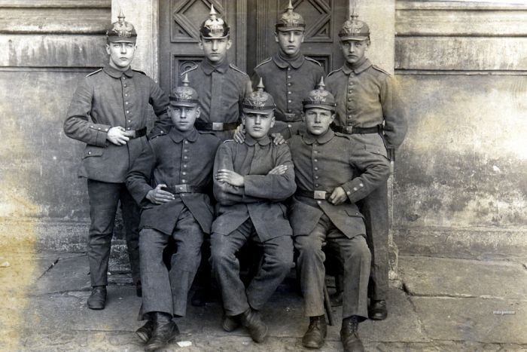
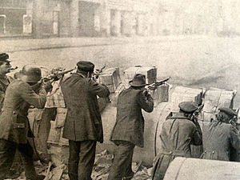
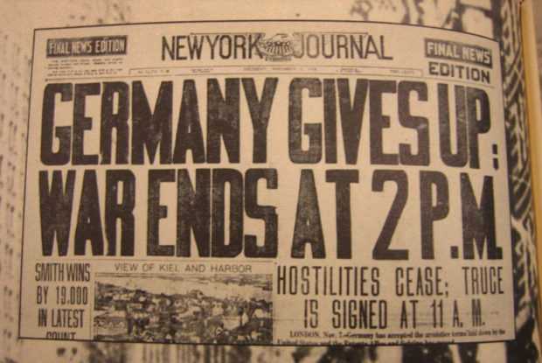
Germany 1919-1920
The impact of defeat – November 1918
The November Revolution – 1918-1919
Establishment of the Weimar Republic 1919
The Weimar constitution and its weaknesses
The Treaty of Versailles

Slide 2
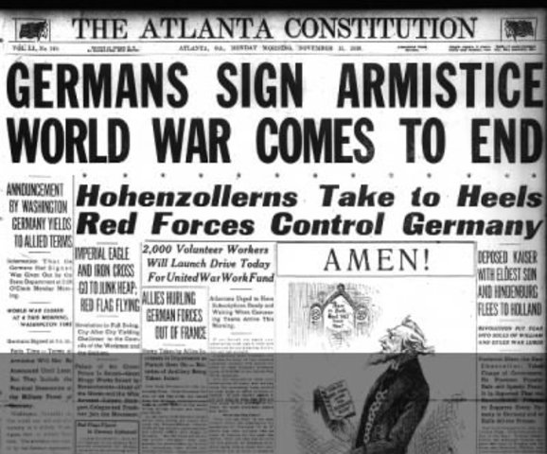
The impact of defeat
Devastating impact economically and socially.
Completely changed the political climate of Germany – from monarchy to republic (democracy)

Slide 3
The November Revolution 1918-1919
German Revolution: https://www.youtube.com/watch?v=DtvJbm_KFzY
Kaiser Wilhelm II abdicated 10th November, a day later armistice signed by Social Democrats ending WW1 – admitting defeat.
Following end of monarchy political unrest. Most popular political party at the time the Social Democratic Party of Germany (SPD) in control, announce Weimar Republic – later called ‘November Criminals’ for signing armistice.
On January 5th 1919, the Spartacists attempted an armed takeover of Berlin (Spartacist Uprising - Communists) – unsuccessful. Government saved by armed bands of ex-soldiers, known as the Freikorps, who defeated the Spartacist rebels.
Revolution ended August 1919 when Weimar Constitution signed.

Slide 4
With Germany on the brink of defeat in World War I and a revolutionary mood sweeping the country, the unpopular emperor Kaiser Wilhelm II was forced to abdicate, ending Germany's monarchy.
Word spread that the Communists, led by Karl Liebknecht, would soon pronounce a communist republic. To prevent this, on November 9th, 1918, the deputy chairman of the Social Democrats, Philipp Scheidemann rushed to the balcony of Berlin's Reichstag parliament to announce the birth of what would become the Weimar Republic.
"Long live the German republic!" he shouted.
But a few hours later, Liebknecht also declared the birth of the ‘free socialist German republic’. Germany was in a state of instability and strife.
Two days later, Germany agreed to sign an armistice that ended the Great War against the Allied forces.
Eventually, the government relocated to Weimar in January 1919, where it was able to establish a parliamentary democracy. But serious problems and unrest still plagued the country.
The terms of Germany's surrender were deemed so humiliating that historians believe they helped sow the seeds for World War II.
It became the basis of the Dolchstoßegende, or the “stab-in-the-back-myth”. Right-wing circles asserted the belief that the German forces had not actually lost the war, but that the country had been betrayed, or stabbed in the back, by civilians at home.
They wanted to blame the so-called “November Criminals”, the politicians involved in the armistice and the November Revolution.
In the following decades, the Dolchstoßlegende and the myth of the November Criminals became a core component of right-wing rhetoric.
What is the perspective of this article? Are there alternative perspectives?

Slide 5
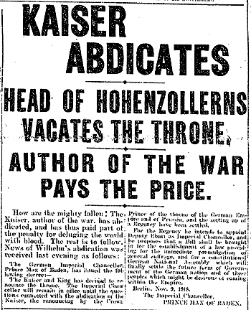
Kaiser Wilhelm II Abdicates
https://www.youtube.com/watch?v=k6uqiavnu-E

Slide 6
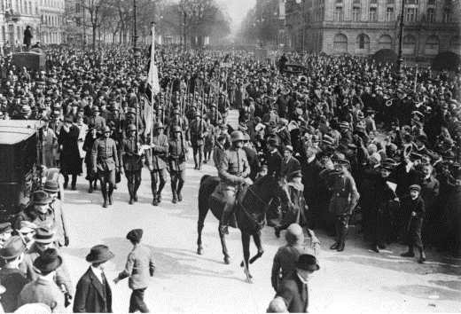
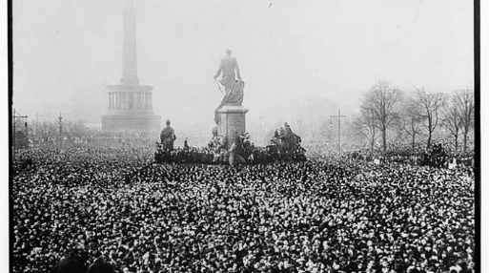
Establishment of the Weimar Republic 1919
https://www.youtube.com/watch?v=KzY0fKz6dXc
10th November (day before end of WW1) a provisional government was announced made up of members of the Social Democratic Party (SDP) and the Independent Social Democratic Party of Germany (USDP).
December 1918, elections held for a National Assembly tasked with creating a new parliamentary constitution.
February 6, 1919, the National Assembly met in the town of Weimar and formed the Weimar Coalition - elected SDP leader Friedrich Ebert as President of the Weimar Republic.

Slide 7
The Weimar Constitution
The German Reich is a Republic.
The government is made of a president, a chancellor and a parliament (Reichstag).
Representatives of the people must be elected equally every four years by all men and women over age 20.
The term of the President is seven years.
All orders of the President must be endorsed by the Chancellor or a Reich Minister.
Article 48 allows the President to suspend civil rights and operate independently in an emergency.
Two legislative bodies (the Reichstag and the Reichsrat) were formed to represent the German people.
All Germans are equal and have the same civil rights and responsibilities.
All Germans have the right to freedom of expression.
All Germans have the right to peaceful assembly.
All Germans have the right to freedom of religion; there is no state church.
State-run, public education is free and mandatory for children.
All Germans have the right of private property.
All Germans have the right to equal opportunity and earnings in the workplace.

Slide 8
The Weimar Constitution and its weaknesses
Weimar Republic
Republic is type of democracy where the people elect/vote a President and political party to rule (not a monarch-Kaiser).
Therefore, needs a constitution (laws about how the country will be run/governed).
Weaknesses (ultimately contributing to Hitler and Nazis being able to take power through the legal/political system)
Proportional representation – an electoral system in which parties gain seats in proportion to the number of votes cast for them – therefore, often differing ideas about how Germany should be governed. When parties disagreed it often meant that the government collapsed, and they needed to have fresh elections – took time and nothing resolved.
Use of emergency powers - Article 48. This enabled the President to make decisions without consulting the Reichstag.

Slide 9
History Heroes Week 8
What impact did the defeat in WW1 have on Germany?

Slide 10
History Heroes Week 8
2. Why was the Weimar Republic established? What did it end?

Slide 11
History Heroes Week 8
3. In what two ways was the Weimar Constitution flawed?

Slide 12
ANSWERS

Slide 13
History Heroes Week 8
What impact did the defeat in WW1 have on Germany?
Devastating impact economically and socially.
Completely changed the political climate of Germany – from monarchy to republic (democracy)

Slide 14
History Heroes Week 8
2. Why was the Weimar Republic established? What did it end?
The Weimar Republic was established as a result of Woodrow Wilson’s terms for peace and the ending of WW1. The democratic republic ended the monarchy in Germany.

Slide 15
History Heroes Week 8
3. In what two ways was the Weimar Constitution flawed?
Proportional representation – an electoral system in which parties gain seats in proportion to the number of votes cast for them – therefore, often differing ideas about how Germany should be governed. When parties disagreed it often meant that the government collapsed, and they needed to have fresh elections – took time and nothing resolved.
Use of emergency powers - Article 48. This enabled the President to make decisions without consulting the Reichstag.

Slide 16
RESULTS

Slide 17

Source of the week

Slide 18
“Today in the Hall of Mirrors [at Versailles] the disgraceful treaty is being signed. Do not forget it! The German people will, with unceasing labour, press forward to reconquer the place among nations to which they are entitled.”
-From the newspaper Deutsche Zeitung (German News) on the day the treaty was signed.

Slide 19
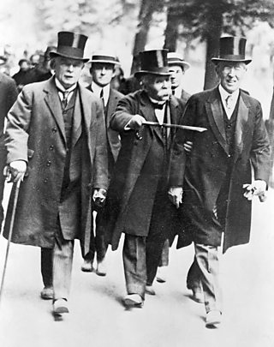
The Treaty of Versailles
https://www.youtube.com/watch?v=vrYhLNQMRro
Germany not invited to negotiations.
Allies (including ‘Big Three’) met at Versailles Palace in France in June1919 to create treaty.
(USA)Wilson's aims:
to end war by creating a League of Nations based on his Fourteen Points
to ensure Germany was not destroyed
not to blame Germany for the war - he hated the Guilt Clause
(France) Clemenceau's aims:
to punish Germany and seek revenge
to return Alsace-Lorraine to France
no League of Nations
an independent Rhineland
huge reparations
to disband the German army so that Germany would never be strong enough to attack France again
(Britain) Lloyd George's aims:
a 'just' peace that would be tough enough to please the electors who wanted to 'make Germany pay', but would leave Germany strong enough to trade
land for Britain's empire
to safeguard Britain's naval supremacy

Slide 20
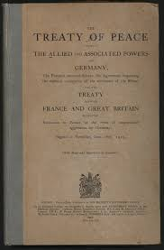
Clauses of the Treaty of Versailles
Germany to accept guilt for starting WW1
Germany had to pay $31.4 billion in reparations
Economically these reparations went on to cripple Germany.
Germany had to make substantial territorial concessions. They lost control of:
Alsace Lorraine (France)
Eupen and Malmedy (Belgium)
North Schleswig (Denmark)
Hulschin (Czechoslovakia)
West Prussia, Posen and Upper Silesia (Poland)
Saar, Danzig and Memel (League of Nations)
All gains from the Treaty of Brest Litovsk (Russia)
All colonies (League of Nations)
Military
No air force
Army limited to 100,000 soldiers
No submarines
6 battleships
Demilitarisation of the Rhineland

Slide 21
Impact of the Treaty of Versailles on Germany
Most Germans rejected the treaty – widespread outrage and anger
‘The Stab in the back Myth’
Signing of the treaty linked to Weimar Republic – German’s did not support new government
Economic repayments caused hyperinflation in 1920s
Harsh terms of the treaty influenced WW2
Use the handout given to you to highlight key impacts of the Treaty of Versailles.

Slide 22
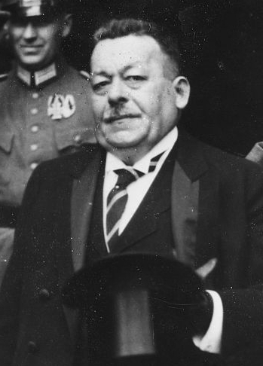
Student activity!
Stay up to date with your readings!
Complete the practice source analysis given to you.
Miss Hawkes will come and check your revision/reading booklets!

Slide 23

Kahoot!
https://create.kahoot.it/details/treaty-of-versailles/612b6d2d-3dc5-4e07-9f6a-b5737ef48d87

Slide 24
PERSPECTIVES of the Treaty
Germany
The Germans hated everything about the treaty:
They were angry that they had not been allowed to negotiate.
'Deutsche Zeitung', a German newspaper, vowed: "We will never stop until we win back what we deserve."
Count Brockdorff-Rantzau, leader of the German delegation at Versailles said Article 231 - the war-guilt clause - was "a lie". Germany officially denied the war-guilt clause in 1927.
There was a revolution (the Kapp Putsch) against the treaty in Berlin in 1920.
Germany hated reparations, and was forced to begin paying them in 1921. They defaulted in 1923 and eventually Hitler refused to pay altogether.

Slide 25
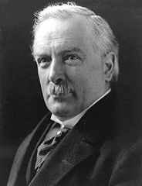
PERSPECTIVES of the Treaty
Britain
Britain gained some German colonies and the German navy was destroyed but:
Lloyd George thought the treaty was too harsh, saying: "We shall have to fight another war again in 25 years time."
The British diplomat Harold Nicolson called it "neither just nor wise" and the people who made it "stupid".
The economist John Maynard Keynes prophesied that reparations would ruin the economy of Europe.

Slide 26
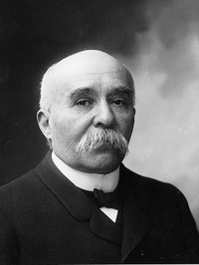
PERSPECTIVES of the Treaty
France
France got Alsace-Lorraine, German colonies, harsh reparations and a tiny German army but:
Many French people wanted an independent, not a demilitarised, Rhineland.
Most French people did not think the League of Nations would protect them against Germany.

Slide 27
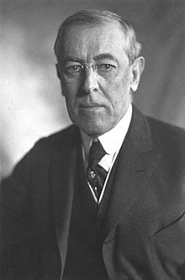
PERSPECTIVES of the Treaty
America
Woodrow Wilson got the League of Nations, and new nation-states were set up in Eastern Europe but:
Wilson thought the treaty was far too harsh.
Self-determination proved impossible to implement - neither Czechoslovakia or Yugoslavia survived as united countries.
Many Americans did not want to get involved in Europe, and in 1920 the American Senate refused to sign the Treaty of Versailles, or join the League of Nations.

